Slide 1
Concurrency in .NET Framework

Slide 2
Summary
Threads
Lock
Mutex
Semaphore
Monitor
[Synchronization] Attribute

Slide 3
Threads
OSs use processes to separate different executing applications
.NET Framework subdivides OS’ process into subprocesses (application domains - System.AppDomain)
One or more threads can run between any number of app domains inside the same managed process
System.Threading provides a number of synchronization types

Slide 4

Concurrency

Slide 5

Lock keyword
WHAT?
Allows defining a scope of code that must be synchronized between threads;
Incoming threads cannot interrupt the current thread.
HOW?
Specify a token that must be acquired by a thread to enter inside the scope which has been locked;
when we want to lock down a private instance method, we can simply pass in an object reference to the current type.

Slide 6
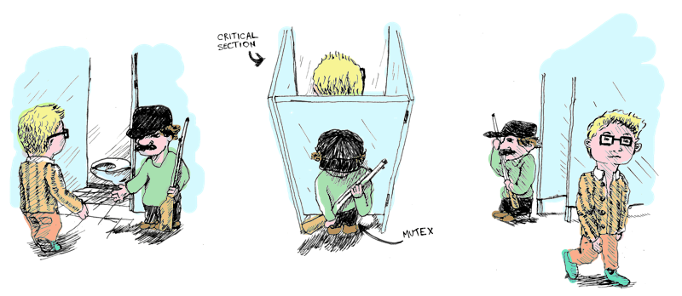
Mutex

Slide 7
Mutex
Similar to lock, but:
can work across multiple processes;
is slower than lock.
Must call
WaitOne() to lock;
ReleaseMutex() to unlock.
Can be released only from the same thread which obtained it.
The primary use for a cross-process Mutex is to ensure that only one instance of a program can run at a time.

Slide 8
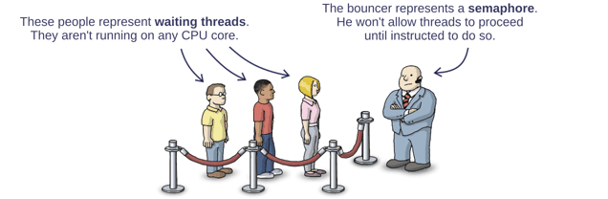
Semaphore

Slide 9
Semaphore
If it has a capacity of one it is like a Mutex or lock.
It has no owner, therefore it is not aware of thread.
Any thread can call Release on a Semaphore;
with a Mutex or lock, only the thread that obtained the lock can release it.
Used for limiting concurrency by preventing too many threads from executing a particular piece of code at once

Slide 10

Monitor

Slide 11
Monitor
The lock is just a shorthand notation for working with the System.Threading.Monitor class;
Must call:
Monitor.Enter() to lock;
Locked scope is wrapped within a try block;
finally block ensures that the thread token is released regardless of any possibility of runtime exception;
Monitor.Exit() to unlock.
Provides more control than lock:
tell the active thread to wait by using Wait();
let the waiting threads know when the current thread is completed via Pulse() and PulseAll().

Slide 12
[Synchronization] Attribute
member of the System.Runtime.Remoting.Contexts namespace;
locks down all instance member code of the object to achieve the thread safety;
will place the object within a synchronized context when the CLR allocates objects which have [Synchronization] Attribute;
objects should derive from ContextBoundObject.

